Slide 1
Linear modelling theory
With categorical explanatory variables

Slide 2

Last week we used straight lines $$μ_{i}=β_{0}+β_{1}×X_{i}$$

Slide 3
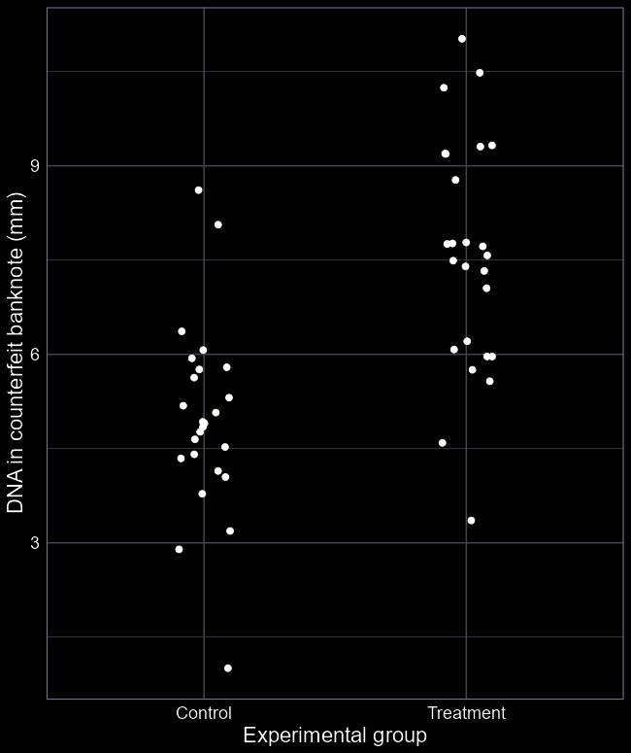
No straight line?
What do we do if we don’t have a continuous variable?
What if we have groups?
Can we draw a line between Control and Treatment?
Is there such a thing as “half a control” or “a third of a treatment”?
Clearly not, but how do we deal with this?

Slide 4
The question

Slide 5
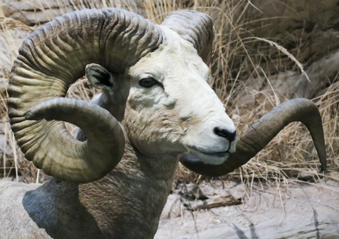
Stone sheep
Wild sheep from Canada
Sexual selection for large horns
Hunters target males with long horns
Hunting *records* started in 1972
Does hunting males with large horns lead to selection pressure?

Slide 6
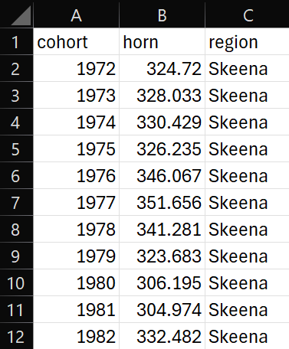

Our data
All hunted sheep are inspected
Various information collected
Of most interest is horn length (mm)
Horn length is our response
Horn length is averaged by cohort, year and region
$y_{i}$ (horn) represents the average horn length for a given year, in a given region
$i$ represents year and region
Any issues?
(Averaging values rarely a good idea)

Slide 7
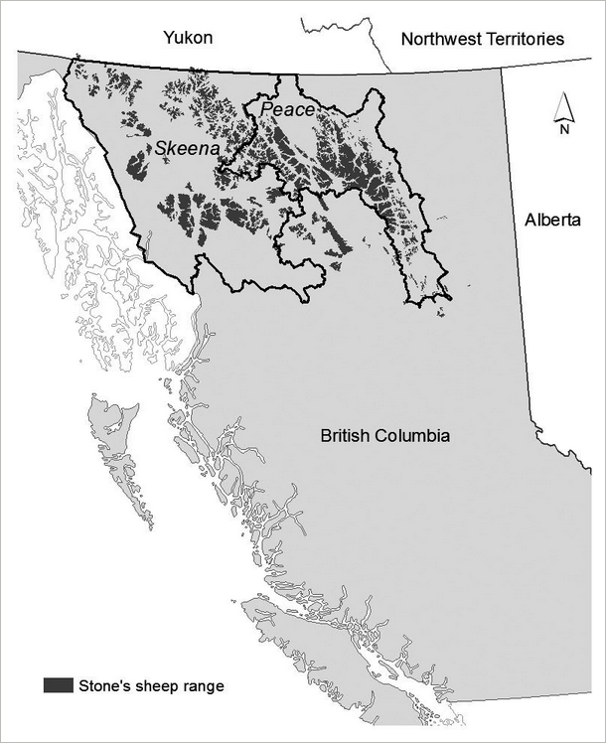
Our explanatory variable
Hunting pressure ideally measured as number hunted given total population size
But population size is insanely difficult to estimate
Instead, we can use region as a simplified version of hunting pressure
Skeena region has low hunting pressure
Peace has high hunting pressure

Slide 8
Get to know your data

Slide 9
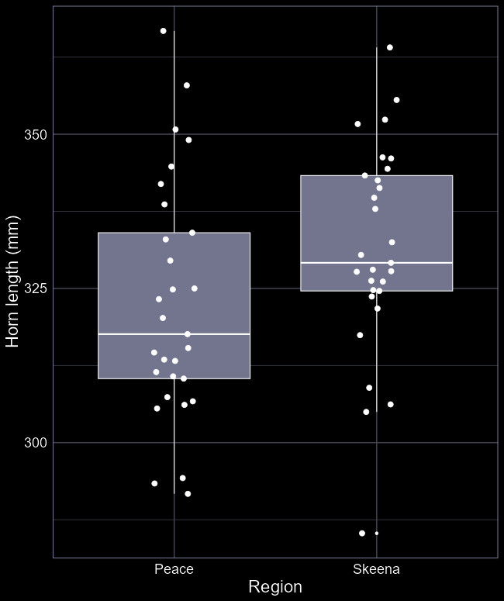
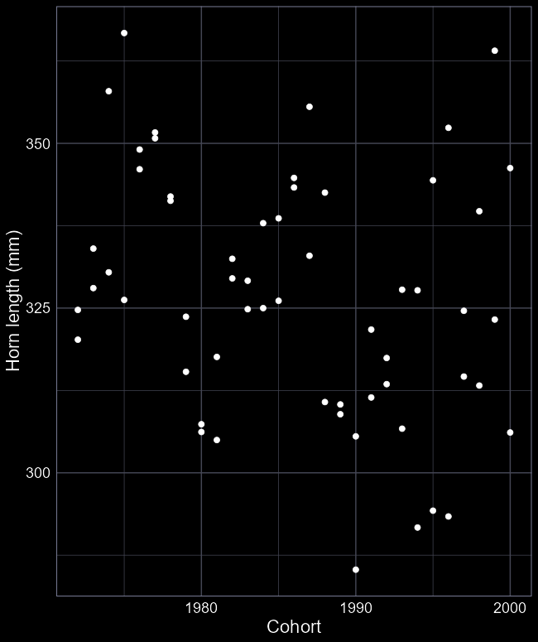
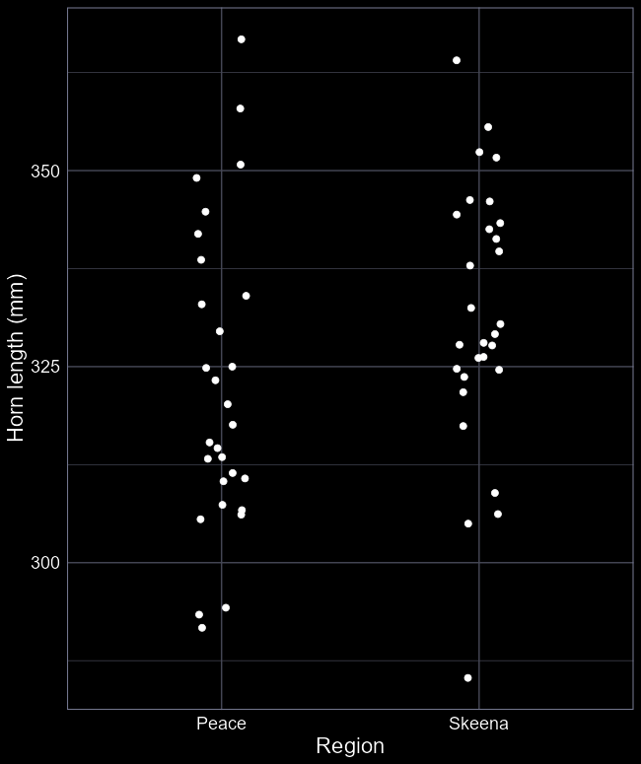
Data visualisation
Any noticeable trend in cohorts?
Any noticeable trend in region?
Arguably, nothing obvious jumping out
Should we stop here?

Slide 10

Question to model
We want to understand how horn length differs in the two regions
$y_{i}$ is horn length
But how do we include the region category?
Our toolkit:
$$y_{i}∼Normal(μ_{i}, σ_{i})$$
$$μ=β_{0}+β_{1}×x_{i}$$
How do we do $β_{1}×$ Region?

Slide 11




Categories in linear models
$μ_{i}=β_{0}+β_{1}×1$ (if $i$is Skeena)
$μ_{i}=β_{0}+β_{1}×0$ (if $i$is Peace)
$$μ_{i}=β_{0}+β_{1}×Skeena_{i}$$
horn | region | skeena | peace
324.74 | peace | 0 | 1
323.68 | skeena | 1 | 0
304.97 | peace | 0 | 1
332.48 | skeena | 1 | 0
364.21 | skeena | 1 | 0
328.74 | peace | 0 | 1
392.45 | peace | 0 | 1
We want region in the model
But region contains strings (i.e. words)
How do you do $4.6×Region$?
You don’t! Behind the scenes R converts your factor in to a series of columns:
We don’t need a peace column because if it’s not skeena (i.e. $skeena = 0$), then it must be peace.
The new skeena column is 1 if the region was skeena, and 0 if not

Slide 12


Categories in linear models
We take all but one category and convert to 0 (not part of this group) or 1 (part of this group)
Multiplying by 0 “turns off” $β_{1}$
Multiplying by 1 “turns on” $β_{1}$
What is $β_{0}$?
The category without a parameter
What is $β_{1}$?
The difference with $β_{0}$
Here:
$β_{0}$ is the horn length in Peace
$β_{1}$ is the difference between Skeena and Peace
$$μ_{i}=β_{0}+β_{1}×Skeena_{i}$$
horn | region | skeena
324.74 | peace | 0
323.68 | skeena | 1
304.97 | peace | 0
332.48 | skeena | 1
364.21 | skeena | 1
328.74 | peace | 0
392.45 | peace | 0

Slide 13
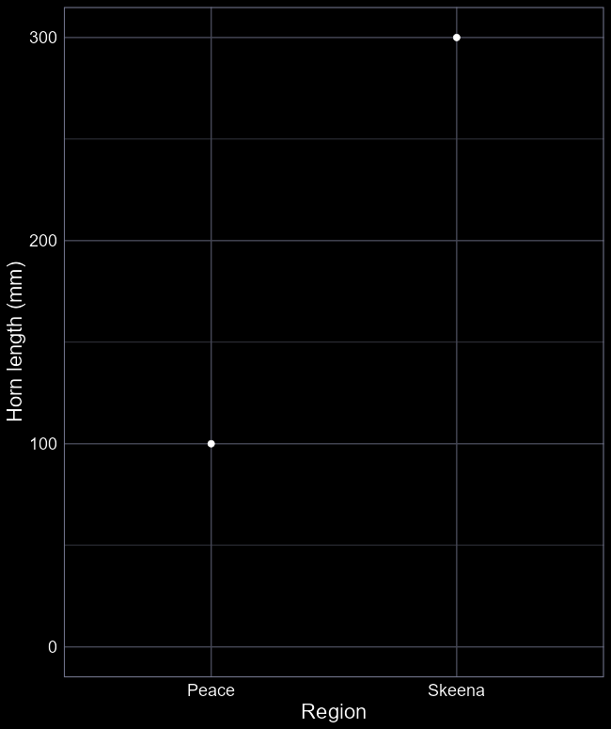
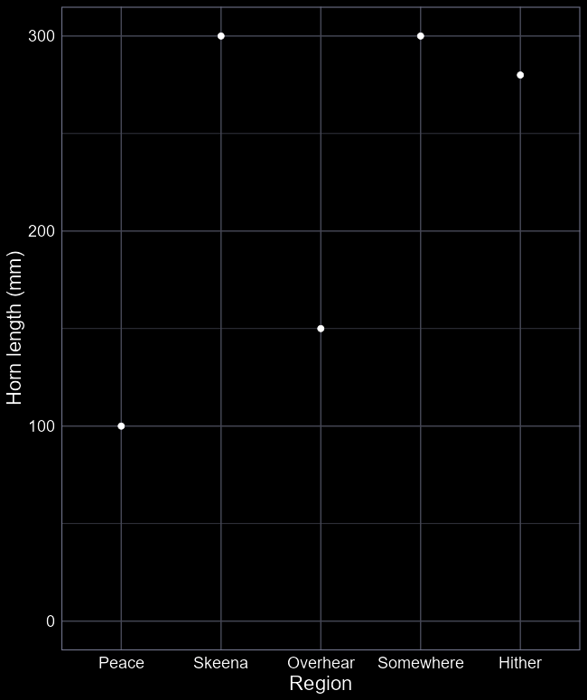








Visually
$β_{0}$ (the “intercept”) is how long horns are in the first group
Here in the Peace region
$β_{1}$ (the “contrast”) is the difference between the first group and the second group
E.g. Peace sheep horns are 100 mm long, and Skeena are 300 mm (in this example).
No limit to the number of groups you can have
Each subsequent group is always the difference from the reference (i.e. the intercept)
$$β_{1}=200$$
$$β_{3}=200$$
$$β_{1}=200$$
$$β_{4}=180$$
$$β_{2}=50$$
$$β_{0}=100$$
$$β_{0}=100$$

Slide 14
Fitting the model

Slide 15
Last week: straight line

Slide 16
This week: Multiple averages

Slide 17
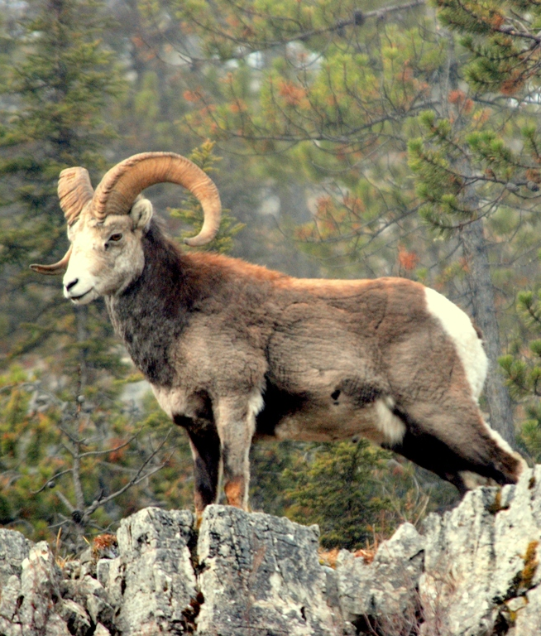

What do we learn biologically?
$y_{i}∼Normal\left(μ_{i}, σ_{i}\right)$
$μ_{i}=322+9×{Skeena}_{i}$
How long are horns in Peace?
322 mm on average
Are horns in Skeena longer or shorter?
Longer
By how much?
9 mm
Does hunting have a selective pressure on horn length?
(Skeena is low hunting, Peace is high)

Slide 18
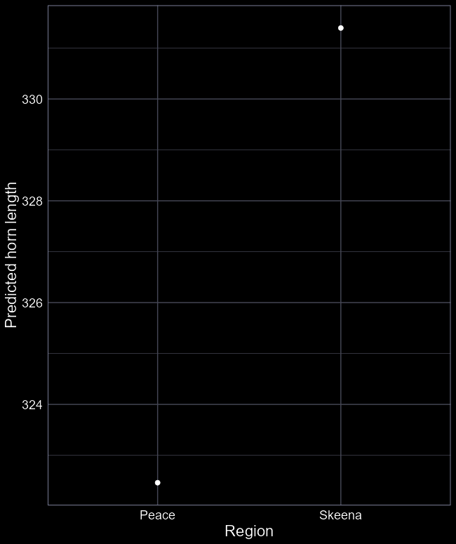
Answering our question
Does greater hunting pressure lead to reduced horn size?
Based on this model: “Yes”
But any caveats?
Do you really know if it’s hunting that’s causing this decline?
Is the data suitable for answering the question?
What hidden assumptions are there?
Assumes these sites are identical in every way other than hunting pressure
Based on this model, being appropriately cautious: “Maybe”

Slide 19
Uncertainty

Slide 20
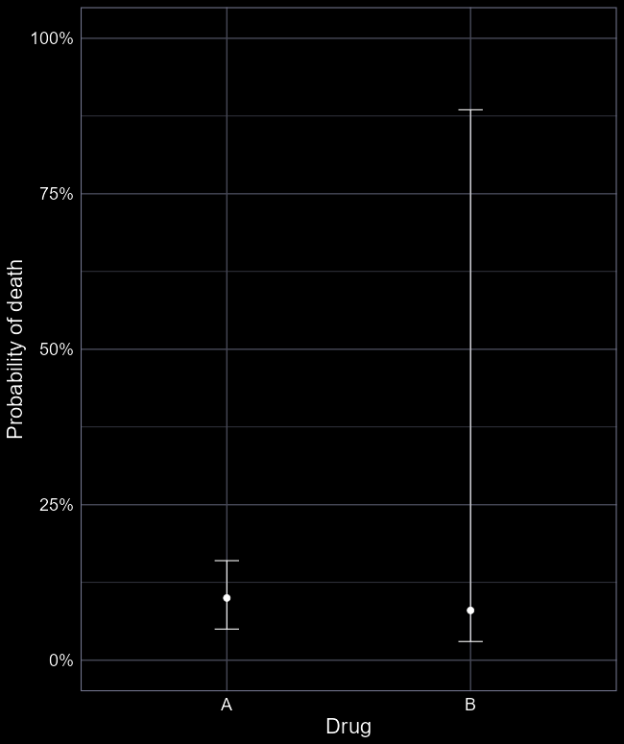
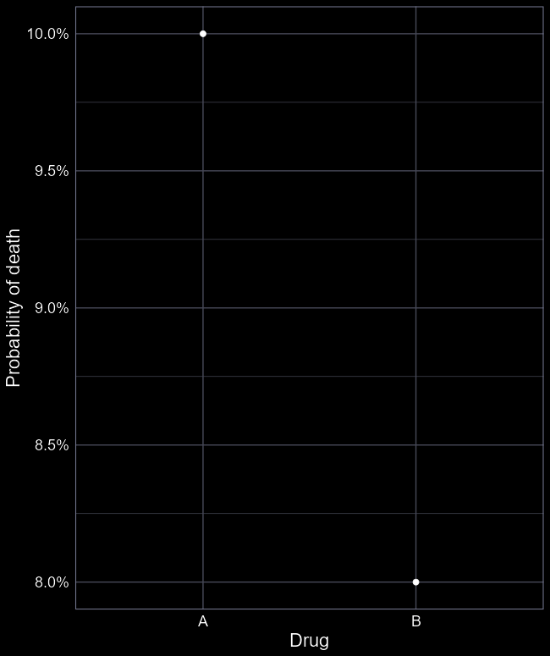
Uncertainty
Are you sure there’s a difference?
What if horn length is super variable?
For example, assume you have a medical condition:
I offer you two medical drugs
Both have side effect of death
Which drug do you take?
Given uncertainty, which drug do you take?
How do we calculate uncertainty?

Slide 21
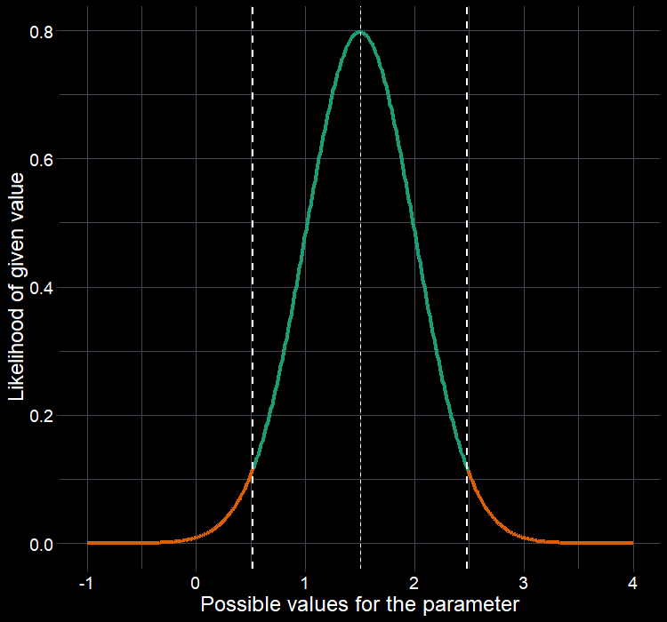
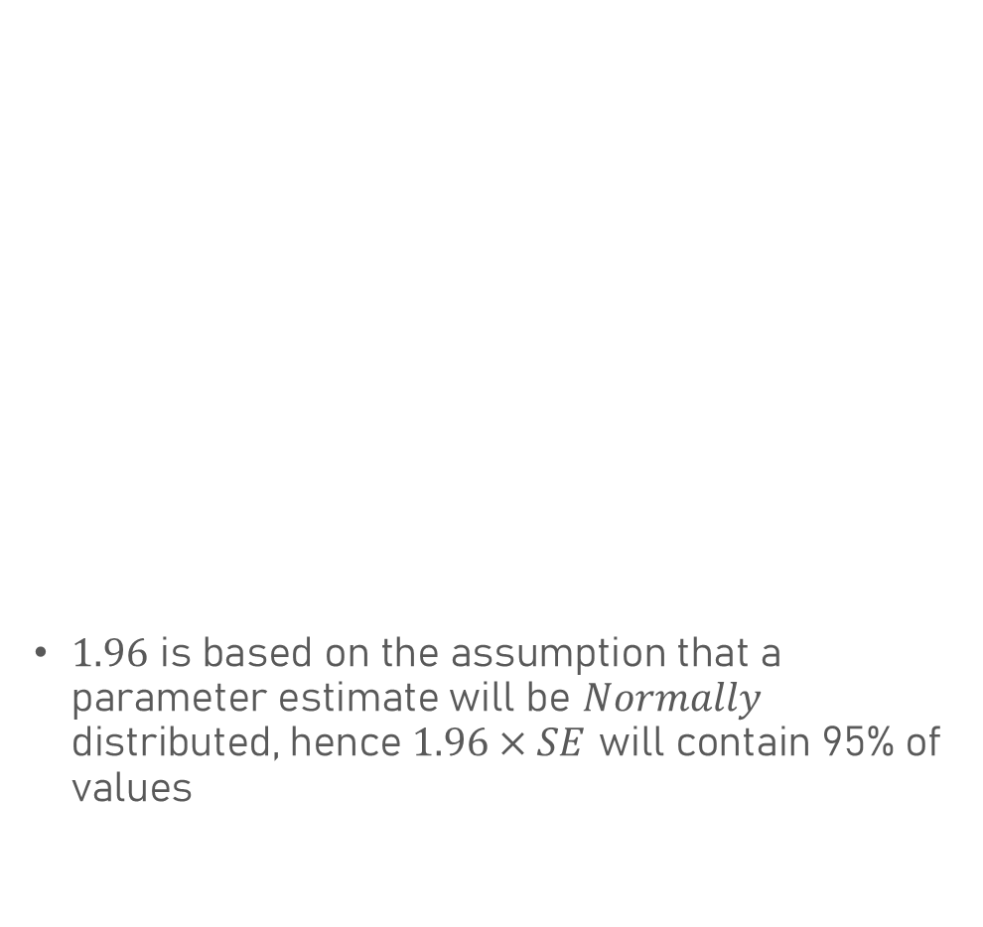


Confidence intervals
So far, we haven’t included any uncertainty in our figures
Assume a simpler model:
$$μ_{i}=β_{0}$$
We have the point estimate for $β_{0}$
But also, the standard error
To go from SE to 95% CI:
$β_{0}95\%CI= β_{0}±SE×1.96$
$1.96$ is based on the assumption that a parameter estimate will be $Normally$ distributed, hence $1.96×SE$ will contain 95% of values
$$β_{0}+SE×1.96$$
$$β_{0}−SE×1.96$$

Slide 22
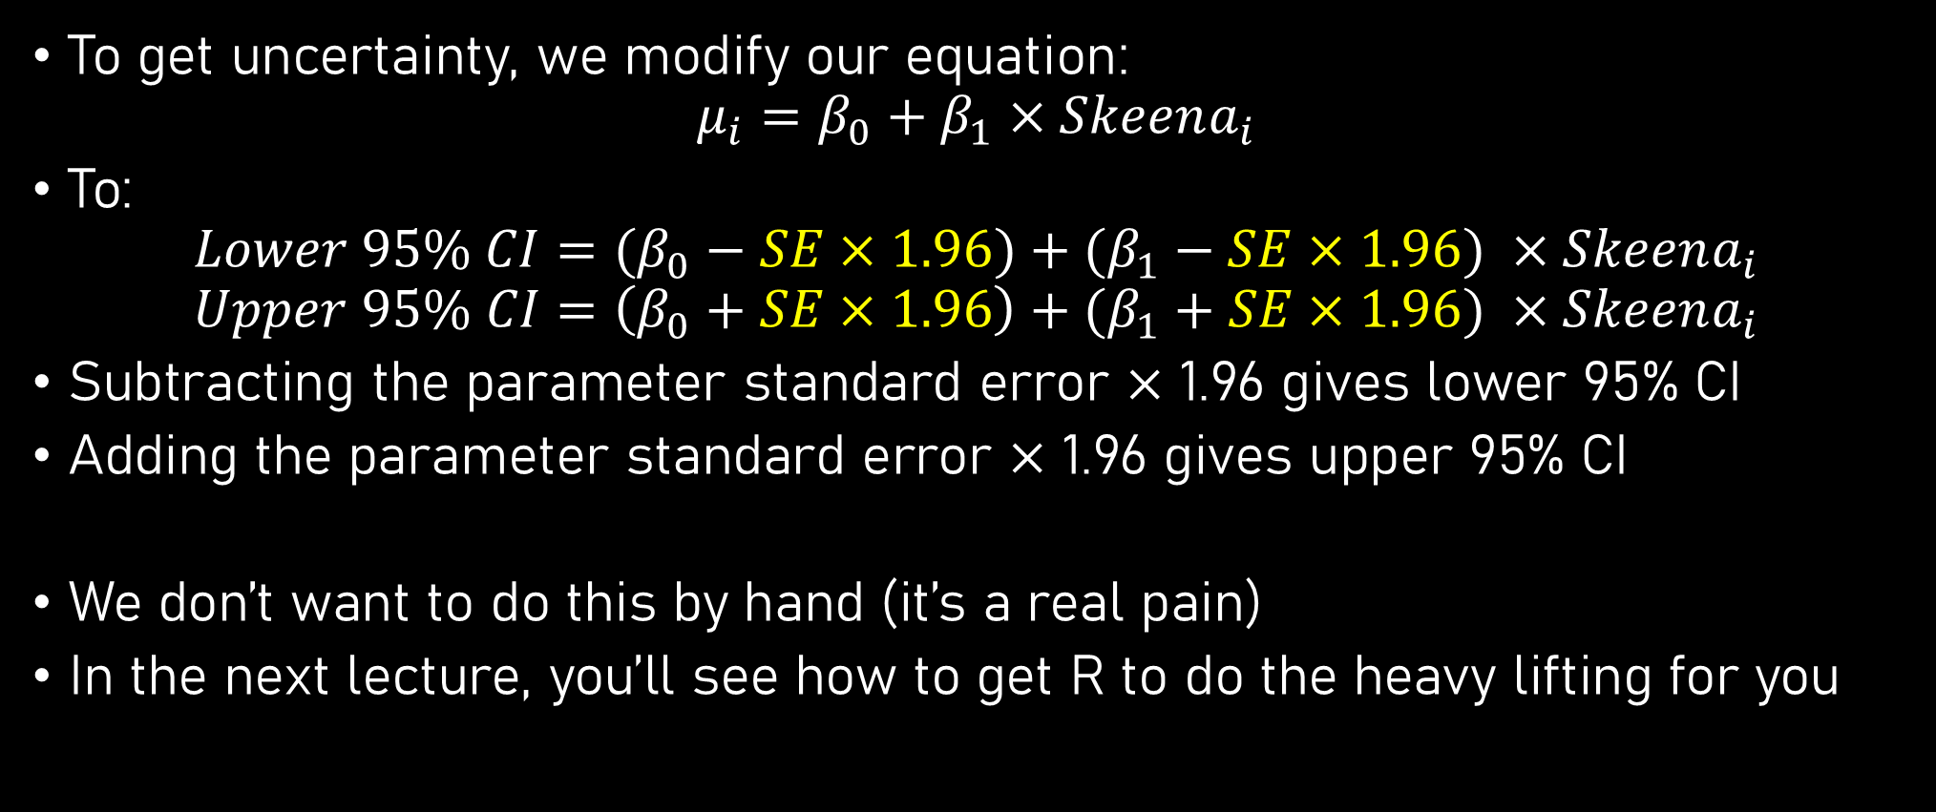
95% CI in linear models
To get uncertainty, we modify our equation:
$$μ_{i}=β_{0}+β_{1}×Skeena_{i}$$
To:
$$Lower 95\% CI=(β_{0}−SE×1.96)+(β_{1}−SE×1.96) ×Skeena_{i}$$
$$Upper 95\% CI=\left(β_{0}+SE×1.96\right)+(β_{1}+SE×1.96) ×Skeena_{i}$$
Subtracting the parameter standard error $×$ 1.96 gives lower 95% CI
Adding the parameter standard error $×$ 1.96 gives upper 95% CI
We don’t want to do this by hand (it’s a real pain)
In the next lecture, you’ll see how to get R to do the heavy lifting for you

Slide 23
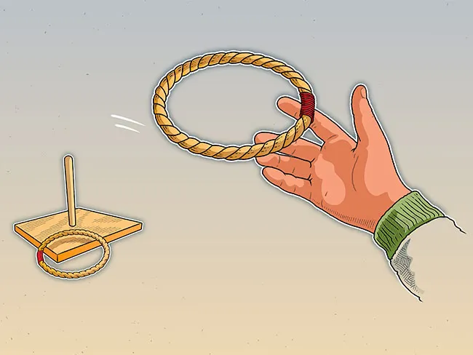
What are confidence intervals?
Ring toss game
If you use a small hoop, then your chance of hitting the target is small, but if you use a “bigger” hoop you have a 95% chance
However, once the hoop has landed, it either overlaps the post or not
This is the same as a 95% CI
Before you run the model, you have a 95% chance of overlapping the true parameter value
However, once you’ve run the model, the 95% CI either contains the true value or not
If we could rewind time and rerun the data collection and analysis 100 times, we’d be able to figure out the most likely range of the true value
But if we only throw it once, we can’t

Slide 24
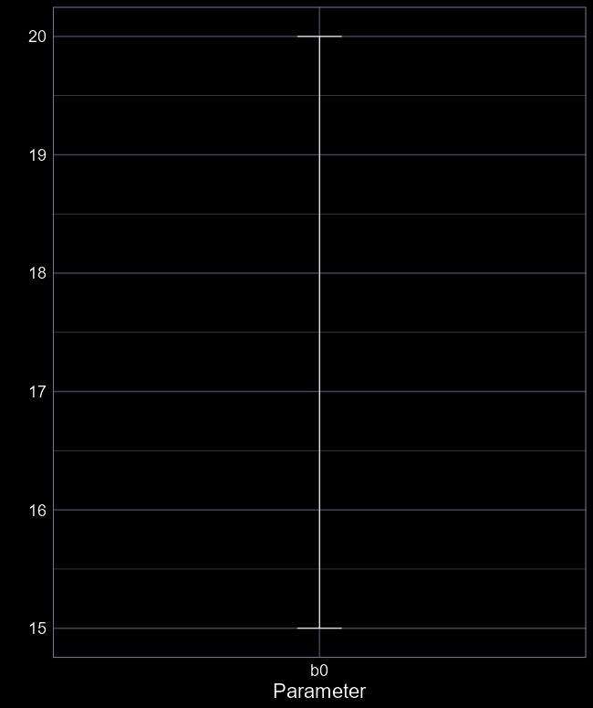
What are confidence intervals?
If we could rewind time and rerun the data collection and analysis multiple times, we’d be able to figure out the most likely range of the true value
But if we only throw it once, we don’t know if the interval overlaps the true value
Does the interval overlap the true parameter?

Slide 25
What are confidence intervals?
A 95% Confidence Interval does not have a 95% chance of containing the true parameter value
It either does, or it doesn’t
Just like the ring is either over the post or not
But, for convenience, we can think of a 95% CI as having a 95% chance of overlapping the true value
It’s not technically correct, so don’t say that to any statisticians

Slide 26
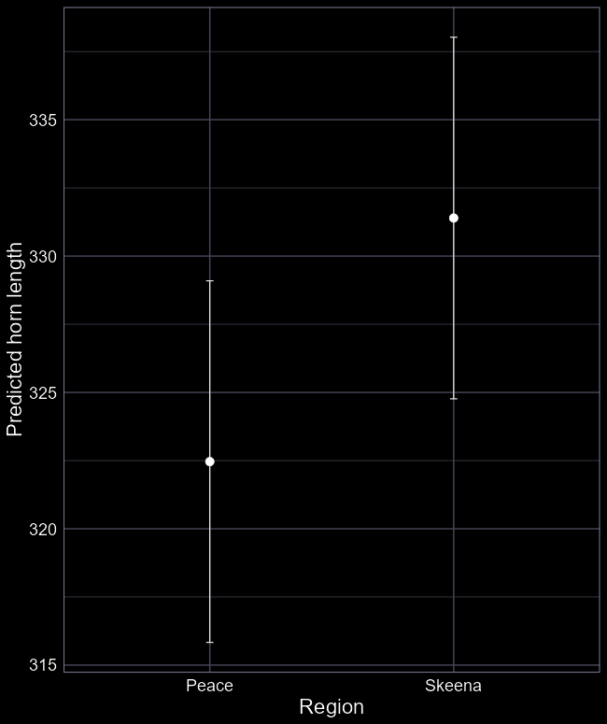
Answering our question
Does greater hunting pressure lead to reduced horn size?
Now with uncertainty!
When making inference consider both the “point estimate” and the uncertainty
My interpretation:
Hunting probably effects horn length, but it’s not impossible that it hunting doesn’t effect horn length.

Slide 27
Dichotomania

Slide 28
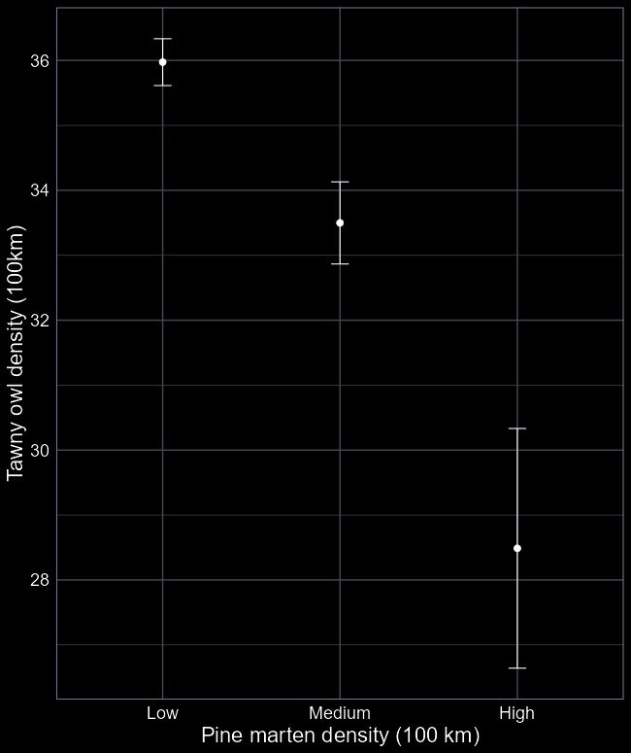
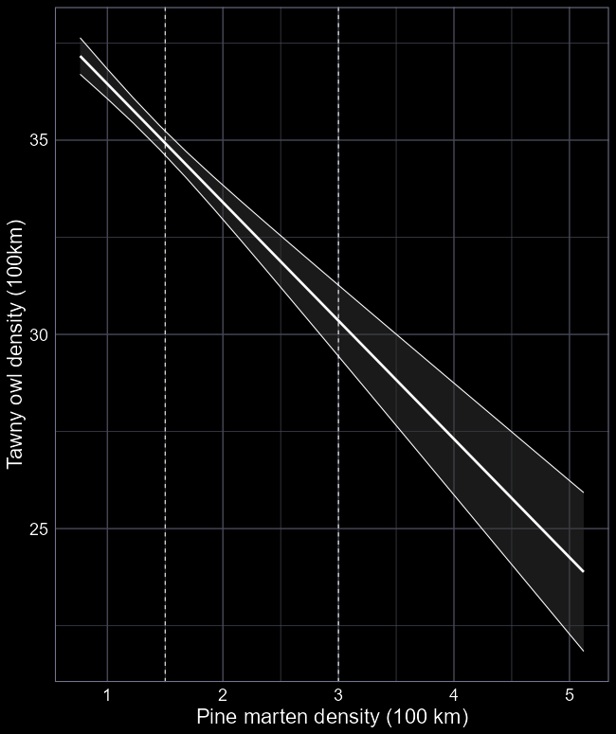
Dichotomania
Humans love to dichotomise things
Taking continuous variables and turning them into categories
Leads to belief that groups are “True”
Rarely the case in the real world
Categories often used when:
Measuring continuous values difficult
Groups are easily available
Following precedent
Categorical variables:
Can help with non-linearity
Sometimes more appropriate
Easier to collect
Continuous variables:
More efficient (fewer parameters)
More accurate inference
Better representation of reality

Slide 29

tl;dr
We always start with a question
Statistics is merely how we answer the question
Start by plotting your data – get a feel for what’s going on
For linear models with a categorical variable, we estimate an intercept ($β_{0}$) and contrast treatments ($β_{1}, etc.$)
We use algorithms to estimate those values
We can then interpret what those parameter values mean biologically
Are they “big”? Should we be concerned? Happy?

